Slide 1

Chapter 2
DS Architecture
DISTRIBUTED SYSTEM

Slide 2

Objectives
At the end of the chapter students will able to:
Understander the Basic Concepts of DS Architecture.
To Explain the Advantages DS Architectures.
To Discuss Important Styles of Architecture for DS.
Understand System Architecture in DS.
Compare and Contrast all the Style of DS Architecture.
Understand the way how to propose DS architecture for organizations.

Slide 3
Introduction
Distributed system is a software system that interconnects a collection of heterogeneous independent computers, where coordination and communication between computers only happen through Message Passing, with the intention of working towards a common goal.
The idea behind distributed systems is to provide a viewpoint of being a single coherent system, to the outside world.
So, the set of independent computers or nodes are interconnected through a Local Area Network (LAN) or a Wide Area Network (WAN) or other type of networking.

Slide 4
Cont…
Distributed systems can be organized in many different ways and we can make a distinction between software architecture and system architecture.
The latter considers where the components that constitute a distributed system are placed across the various machines.
The former is more concerned about the logical organization of the software: how do components interact, in what ways can they be structured, how can they be made independent, and so on.
A key idea when talking about architectures is architectural style and a style reflects the basic principle that is followed in organizing the interaction between the software components of distributed system.

Slide 5
Cont…
Distributed system architectures are bundled up with components and connectors.
Components can be individual nodes or important components in the DS whereas connectors are the ones that connect each of these components.
Component: A modular unit with well-defined interfaces, replaceable, reusable parts.
Connector: A communication link between modules which facilitates coordination or cooperation among components.

Slide 6
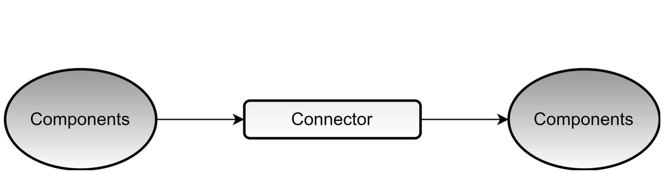
Cont…
So the idea behind distributed architectures is to have these components presented on different platforms, where components can communicate with each other over a communication network in order to Achieve Specifics Objectives.

Slide 7
Cont…
One of the major disadvantages of distributed systems is the complexity of the underlying hardware and software components arrangement.
Distributed system often complex piece of software of which the components are dispersed across multiple machines.
To master their complexity it is curtail that these system and all components are properly and scientifically organized/arranged.
Here to Organizing, Structure, Connect, Manage and Create communication b/n each components of DS, it is important to use the approach/Science of Architectural Technology.

Slide 8
Architectural Styles
There are four different Architectural Styles and the basic idea is to organize logically different components, and distribute those computers over the various machines.
The four important styles of architecture for distributed systems are:
Layered Architectures
Object-Based Architectures
Data-Centered Architectures
Event-Based Architectures

Slide 9
Layered Architectural Styles
The layered architecture separates layers of components from each other, giving it a much more Modular Approach.
A well known example for this is the OSI Model that incorporates a layered architecture when interacting with each of the components.
Each interaction is sequential where a layer will contact the adjacent layer and this process continues, until the request is been provided to.
But in certain cases, the implementation can be made, so that some layers will be skipped, which is called cross-layer coordination.
Through cross-layer coordination, one can obtain better results due to Performance Increase.

Slide 10
Cont…
The basic idea for the layered style is: components are organized in a layered fashion where a component at layer L is allowed to call components at the underlying layer Li, but not the other way around.
This model has been widely adopted by the networking community and an key observation is that control generally flows from layer to layer in which Requests Go Down the Hierarchy whereas the Results Flow Upward.

Slide 11
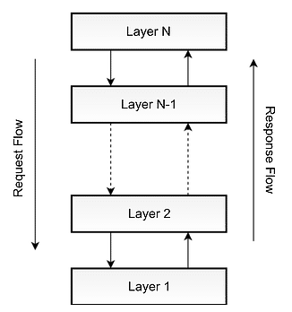
Cont…

Slide 12
Cont…
The layers on the bottom provide a service to the layers on the top and the request flows from top to bottom, whereas the response is sent from bottom to top.
The advantage of using this approach is that, the calls always follow a predefined path, and that each layer can be easily replaced or modified without affecting the entire architecture/system in the given distributed system.

Slide 13
Object-Based Architectural Styles
This Architecture Style is based on Loosely Coupled Arrangement of objects or components in the system.
Like in layer architecture, this does not have a Sequential set of steps that needs to be carried out for a given call.
Each of the components are referred as objects, where each object can interact with other objects through A Given Connector or Interface.
These are much more direct where all the different components can interact directly with other components through a Direct Method Call.

Slide 14
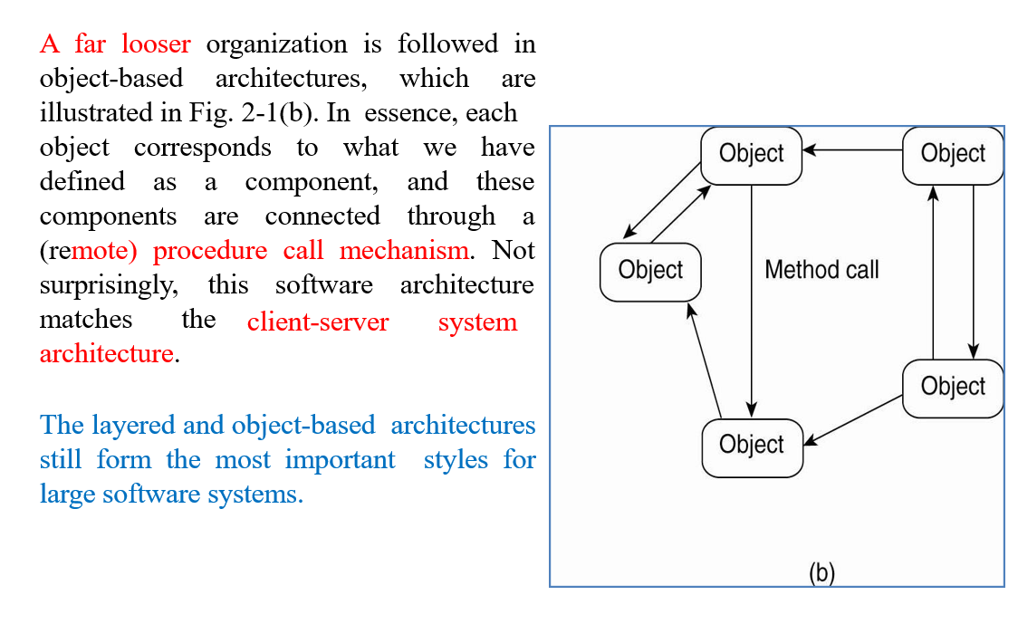
Cont…

Slide 15
Cont…
As shown in the above figure, communication between object happen as Method Invocations.
These are generally called Remote Procedure Calls (RPC).
Some popular examples are Java RMI, Web Services and REST API Calls.
Component = object
Connector = RPC or RMI
The synchronization process needed to be asynchronous, which has led to Data Centered Architectures and Event Based Architectures.

Slide 16
Data-Centered Architectural Styles
As the title suggests, this architecture is based on a data center, where the primary communication happens via a central data repository and this common repository can be either active or passive.
This is more like a producer consumer problem and the producers produce items/goods and store into a common data store, and to utilize the stored items/goods the consumers can request data from it.

Slide 17
Cont…
This common repository, could even be a simple database, but the idea is that, the communication between objects happening through this shared common storage.
This supports different components (or objects) by providing a persistent storage space for those components (such as a MySQL database).
All the information related to the nodes in the system are stored in this persistent storage.

Slide 18
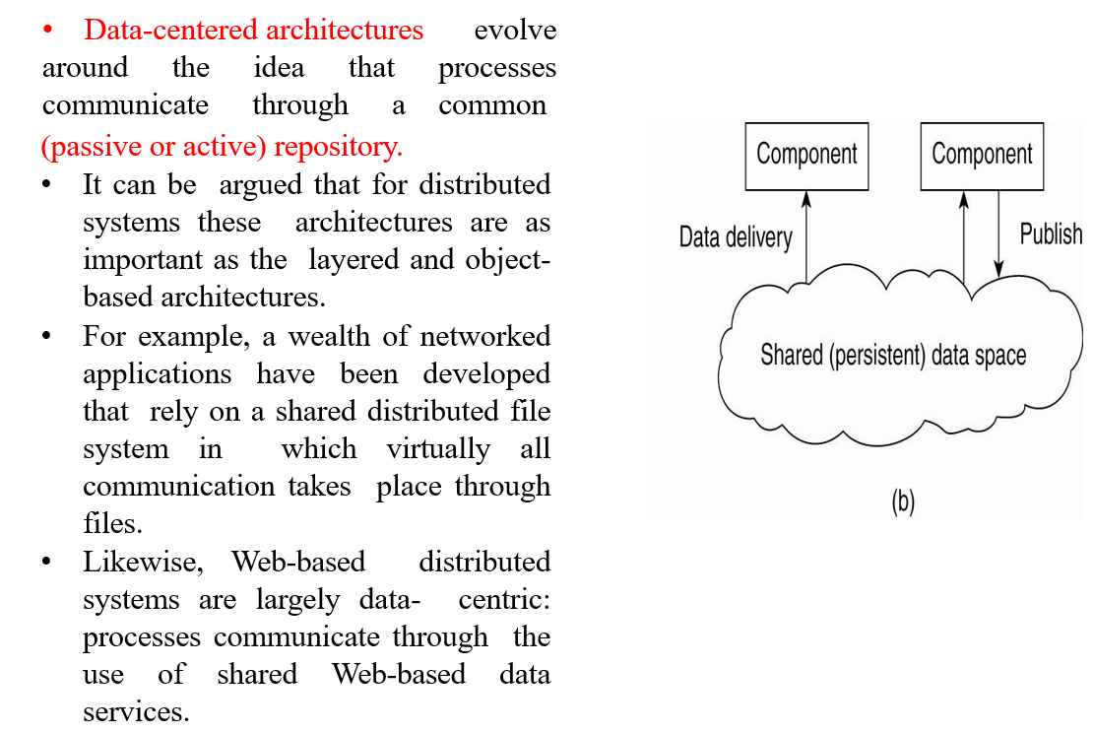
Cont…

Slide 19
Event-Based Architectural Styles
The entire communication in this kind of a system happens through events, when an event is generated, it will be sent to the bus system.
With this, everyone else will be notified telling that such an event has occurred so, if anyone is interested, that node can pull the event from the bus and use it.
Sometimes these events could be data, or even URLs to resources, so the receiver can access whatever the information is given in the event and process accordingly.
Processes communicate through the propagation of events through all the components via network.

Slide 20
Cont…
These events occasionally carry data and an advantage in this architectural style is that, components are loosely coupled.
One major advantage is that, these heterogeneous components can contact the bus, through any communication protocol.
A specific bus, should have the capability to handle any type of incoming request and process accordingly.

Slide 21
Cont…
In event-based architectures, processes essentially communicate through the propagation of events, which optionally also carry data.
For distributed systems, event propagation has generally been associated with what are known as publish/subscribe systems.
The basic idea is that processes publish events after which the middleware ensures that only those processes that subscribed to those events will receive them.
The main advantage of event-based systems is that processes are loosely coupled.

Slide 22
System Architecture
It is refers to the logical organization of distributed systems into software components or how are processes organized in a system, where do we place software components deciding on software components, their interaction.
Now that we have briefly discussed some common architectural styles, let us take a look at how many distributed systems are actually organized by considering where software components are placed.
Deciding on software components, their interaction, and their placement leads to an instance of a software architecture, also called a system architecture.

Slide 23
Cont…
There are three views toward system architectures:
Centralized Architectures
Decentralized Architectures
Multi-Tired(2, 3….N) Architectures

Slide 24
Centralized System Architecture
This types of system architecture is also called Client/Server Architecture.
The clients that request services from servers helps us understand and manage the complexity of distributed systems and that is a good thing.
A Server: is a process implementing a specific service, for example, a file system service or a database service.
A Client: is a process that requests a service from a server by sending it a request and subsequently waiting for the server's reply.
This Client-Server interaction, also known as request-reply behavior of the system.

Slide 25
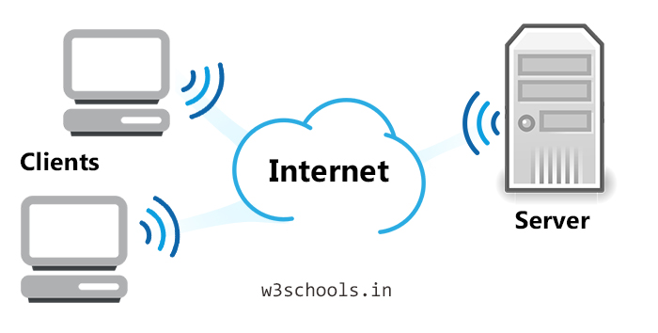
Cont…

Slide 26
Decentralized /Distribution Architectures
Vertical Distribution
It refers where the different tiers correspond directly with the logical organization of application place logically different components on different machine.
Horizontal Distribution
Physically split up the client or the server into logically equivalent parts.
An example is a peer-to-peer system where processes are equal and hence each process acts as a client and a server at the same time.

Slide 27
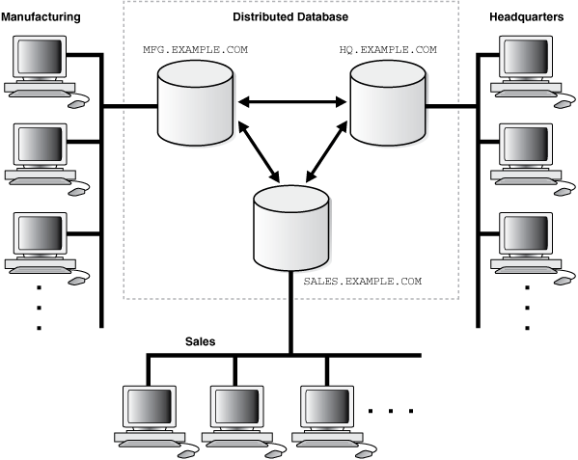
Cont…

Slide 28
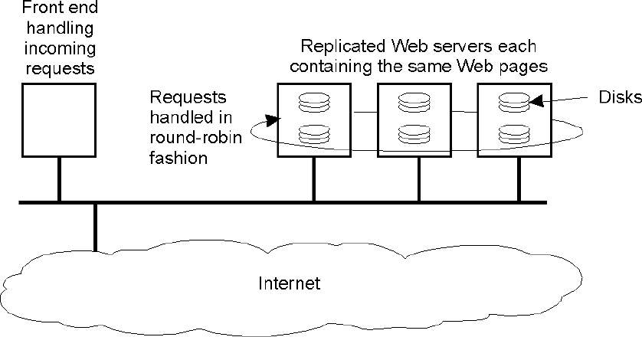
Cont…
In modern architectures (Horizontal Distribution) a client or server may be physically split up into logically equivalent parts, but each part is operating on its own share of the complete data set, thus balancing the load.
A class of modern system architectures that support horizontal distribution, known as peer-to-peer systems.

Slide 29
Multi-tiered Architectures: Two Tier
In the basic client-server model, processes in a distributed system are divided into two (possibly overlapping) groups.
A server is a process implementing a specific service, for example, a file system service or a database service.
A client is a process that requests a service from a server by sending it a request and subsequently waiting for the server's reply.
This client-server interaction, also known as Request-Reply Behavior

Slide 30
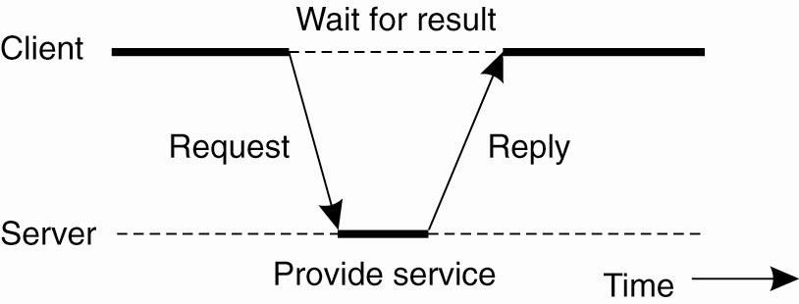
Cont…
Connection less (UDP) and Connection oriented methods (TCP) are used to implement this communication.
The trouble is that setting up and tearing down a connection is relatively costly, especially when the request and reply messages are small.
The main issues is how to draw a clear distinction between a client and a server.

Slide 31
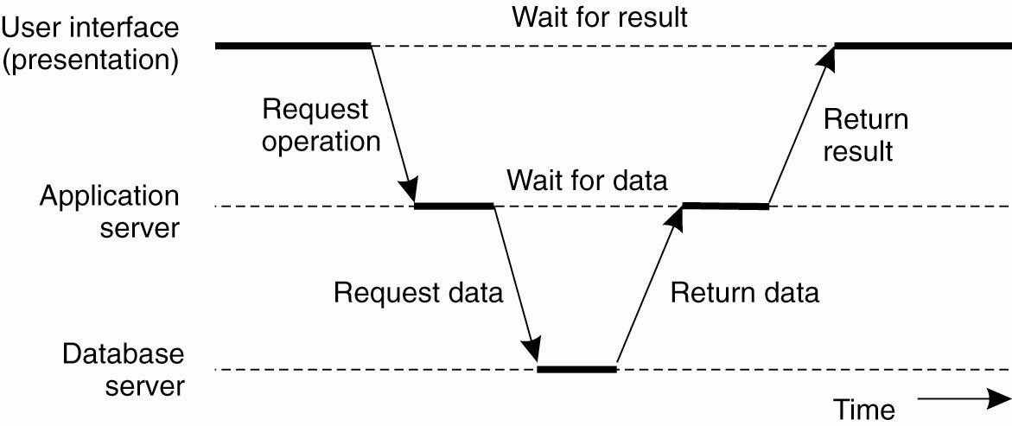
Multi-tiered Architectures: Three Tier

Slide 32
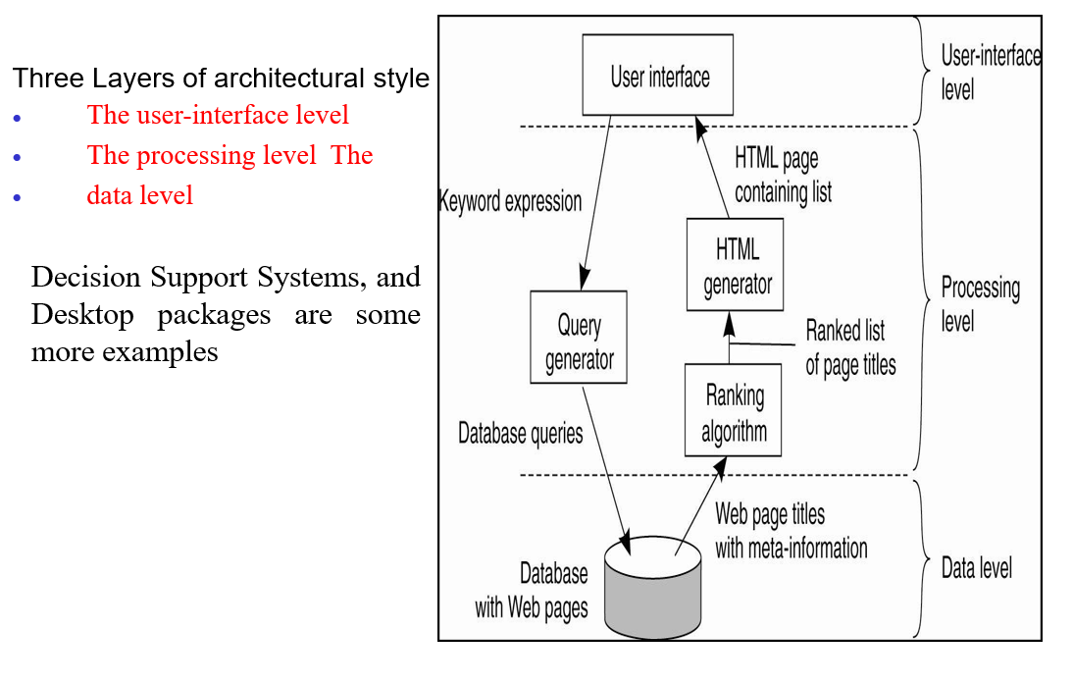
Cont…

Slide 33
Reading Assignment
N-Tier Architecture
Resource Oriented Architecture
Service Oriented Architecture
Compare each Architecture Style
Read related references about architecture.

Slide 34
THANK YOU!!!
QUESTIONS???

